Slide 1
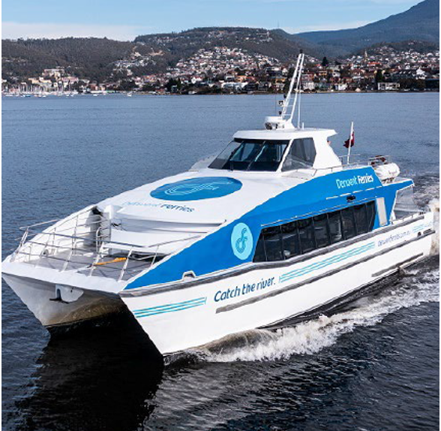
Clarence City Council
Derwent Ferry Expansion Site Feedback
Community feedback
August 2024

Slide 2
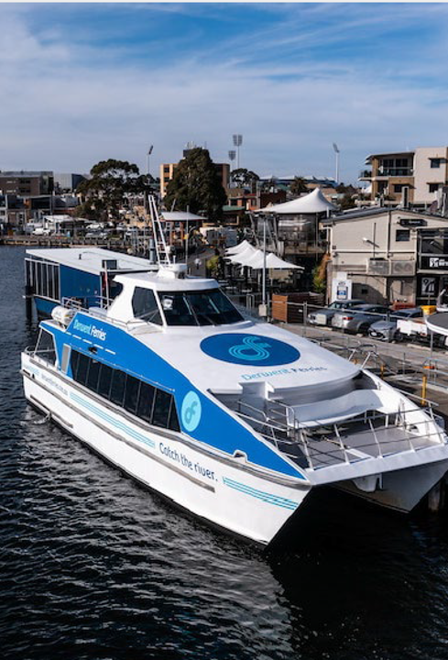
Consultation
Table of Contents
  Project Summary
  Consultation Methodology
  How we communicated
  Who we heard from
  What we heard
  Appendix
    Digital engagement summary
    What was asked – online survey questions
    Detailed results from each survey question
    Lindisfarne ABS 2021 census snapshot
    Written submissions – organisations and individuals

Slide 3
Project Summary
The development of infrastructure to enable the expansion of the Derwent River Ferry Service is being progressed as a component of the Greater Hobart City Deal.
Initial priority locations for new or upgraded terminals include Lindisfarne, Wilkinsons Point and Sandy Bay.
Specific sites at each of these locations have been assessed against established criteria with Lindisfarne having two potential locations to consider – Lindisfarne Sailing Club and Natone Street.
At Council’s meeting on 17 June 2024, Council endorsed consultation with the community on the two site options for a ferry terminal located in Lindisfarne.

Slide 4
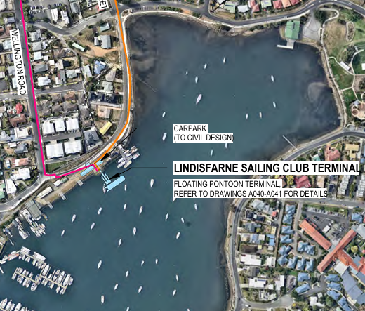
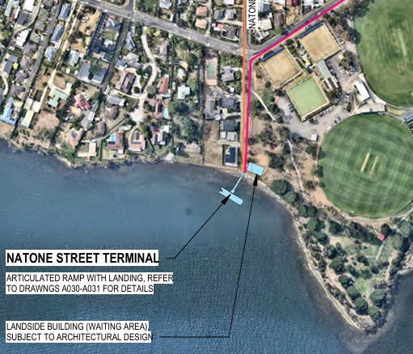
Lindisfarne ferry terminal proposed options for consultation
Site 1: Lindisfarne Sailing Club
Site 2: Natone Street

Slide 5
Consultation Methodology
Consultation was open for four weeks from 8 June to 16 July 2024.
Consultation approach:
Your Say online Survey (also available in hard copy at council chambers).
Online map tool to drop pins with ideas, comments or suggestions.
Email a submission.
Call and speak to an officer.

Slide 6
How we communicated
We adopted a range of different communication channels to reach as many people as possible about the opportunity to have their say.
Council website banner to direct respondents to the Your Say page.
Facebook posts throughout the consultation period.
Eastern Shore Sun newspaper ad (delivered to every house in Clarence).
Ongoing media interest throughout the consultation period with mentions on both radio and print media.
Direct contact with key stakeholder groups, organisations and businesses.

Slide 7
Who we heard from
Key statistics
627 survey responses received.
Total page visits was 2,890.
11 map pins submitted.
55 email submissions received.
93% of respondents live in Clarence.
73% of respondents live in Lindisfarne, Geilston Bay and Rose Bay.
Key Statistics
481 respondents lived withing 5km of the Lindisfarne Sailing Club Site.
471 respondents lived within 5km of the Natone Street site.
There was a good range of ages across the responses received. With 478 respondents aged between 20-69.
Some responses received from those living outside of Clarence indicated that they have a mooring in the Bay.

Slide 8
Who we heard from – a snapshot of organisation email submissions
Incat
Bicycle Network Tasmania
Crew Fitness
Motor Yacht Club of Tasmania
Derwent Storms Dragon Boat Club
Lindisfarne Bay Boat Yard
Dr Rosalie Woodruff MP, Leader of the Tasmanian Greens
Residents and community members

Slide 9
What we heard about commuter behaviour
83% of respondents confirmed they travel at least once a week or more into Hobart CBD.
68% of travel to Hobart CBD is via car. With 24% catching public transport (bus or Bellerive Ferry).
7 in 10 respondents expect they would use a ferry from a location in Lindisfarne.
6 in 10 respondents expect to use the Lindisfarne ferry at least once a week or more.
Nearly 7 in 10 respondents would prefer to access the Lindisfarne ferry without using a car. With 49% preferring to walk, ride or use a scooter as the preferred method of travel to the ferry.
Only 3 in 10 respondents would use a car to travel to the Lindisfarne ferry.

Slide 10
What we heard about the two proposed sites
65 % of respondents agree that Natone Street is a good site for the ferry terminal.
46% of respondents agree that the Lindisfarne Sailing Club location is a good site for the ferry terminal.
47% of respondents said they would use the Natone Street site.
35% of respondents said they would use the Lindisfarne Sailing Club Site.
18% of respondents were unsure or would use either site.
Of the respondents that said they would most likely use the ferry, the split between the two sites in terms of preference is equal at 43%each.
Residents who were unsure or not likely to use the ferry had a clear preference for the Natone Street site.

Slide 11
Key positive themes for Lindisfarne Sailing Club as the preferred site for the ferry terminal
Central site, close to shops and Village.
Less exposed. Calmer waters and more shelter.
Better connection with existing bike paths and bus stops.
Feeling of a safer spot, that is well lit at night.
Established infrastructure so cheaper to build.
Close to retirement village giving residents easy access to Hobart CBD.
Good easy access.
Larger catchment surrounding the site.
Will benefit the sailing club with community facilities on a site that needs upgrading.
Better for visitors.
Easier access for Geilston Bay and Rose Bay residents.
Pier is a good location for a café or restaurant.
Carparking available.

Slide 12
Key positive themes for Natone Street as the preferred site for the ferry terminal
Less impact on existing water users.
Easier turning circle for ferry.
No moorings nearby.
Faster trip between destinations.
More car parking potentially available.
Blank site allowing for more options.
Easier access to closer residential area and use of the ferry.
Away from busy Village.
Space for buses and drop off areas.
Closer for Geilston Bay residents to access ferry terminal.
Less impact on residence.
Wont impact on the sailing club and its activities in the Bay.
Improved connection for walkers and bike users.
May create more investment in the local play park adjacent to the site.

Slide 13
Key negative themes for Lindisfarne Sailing Club as the preferred site for the ferry terminal
Existing users of the Lindisfarne Bay will be impacted.
Wash from the ferry and safety concerns for users in the Bay.
Parking concerns.
Increased traffic congestion.
Slower ferry trip.
Sailing club activities will be impacted. Could displace the Sailing club.
Concern over bus connections and if there is space for a bus stop near the terminal.
Concern over connections and access to this site.
Impact on local residents.
Impact on local wildlife.
Concern that Lindisfarne has an older demographic that will not use the ferry service.
Generally not a good site.

Slide 14
Key negative themes for Natone Street as the preferred site for the ferry terminal
More people will drive to this location.
More parking will be needed.
Too exposed.
No current infrastructure.
Less central location. Further from shops.
Isolated. Feeling of site being less safe at night.
No existing infrastructure. It will cost more to build.
Impact on local residents. Too close to houses.
Less walkable. Less links and harder to access.
Increased traffic in local area.
Noise and light from ferry at night may impact on nearby residents.
Too close to play park and dog park. It will impact the uses of these recreation spaces.
Further from Rose Bay so residents would not use the ferry.

Slide 15
General site comments
General support for Lindisfarne as the location for a ferry service – not location specific.
A ferry service will reduce traffic on the bridge.
A ferry service is an easier commute.
A new ferry will be good for the community and good for businesses.
5 in 10 respondents support the introduction of parking restrictions at and surrounding the ferry terminal.

Slide 16
Summary of email submissions received – key themes
Concerns about Lindisfarne Sailing Club (LSC) site
Safety and Navigation: Many submissions expressed concern about the safety and navigational challenges posed by the proposed ferry terminal at the Lindisfarne Sailing Club site. The presence of multiple recreational activities (sailing, rowing, dragon boating) and the confined space within the Bay are highlighted as potential risks.
Impact on existing activities: The addition of a ferry terminal is seen as a disruption to the current use of the bay, which includes training for various water sports and recreational boating.

Slide 17
Summary of email submissions received – key themes
Support for Natone Street Site
Better Accessibility and Infrastructure: Many submissions express support for the Natone Street site due to its perceived better accessibility, parking availability, and minimal disruption to existing bay activities.
Safety and Efficiency: The site is seen as safer and more efficient, with fewer interactions between the ferry and recreational users, and a quicker approach for the ferry.
Parking and Traffic Issues
Limited parking: Both sites have concerns about parking, but the Lindisfarne Sailing Club site is viewed as particularly problematic due to already existing congestions and limited space.
Traffic Flow: Increased traffic and its impact on local roads, especially around the Lindisfarne Sailing Club site, are a concern.

Slide 18
Summary of email submissions received – key themes
Social Impact
Disruption to local community: Submissions highlighted the potential negative impact on the local community, including noise, safety concerns for children and elderly residents, and overall lifestyle disruption.
Operational Concerns
Ferry wake and speed: The impact of ferry wake on smaller boats, current infrastructure, moorings and on those using the bay for recreational activities, as well as the requirement for the ferry to slow down in the bay, are noted as potential challenges.
Loss of mooring spaces: The proposed terminal at Lindisfarne Sailing Club site would reduce the number of available mooring spaces, affecting boat owners.

Slide 19
Summary of email submissions received – key themes
General Sentiment
Preference for Natone Street: There is a strong preference for the Natone Street site among many of the email submissions, with reasons ranging from safety and efficiency to minimal disruption of existing activities.
General impressions: There is strong sentiment for the consideration of safety, infrastructure, and the impacts on existing bay activities in deciding on a preferred site.

Slide 20
Appendix
Digital engagement summary
What was asked – online survey questions
Detailed results from each survey question
Lindisfarne ABS 2021 census snapshot
Written submissions – organisations and individuals

Slide 21
Digital engagement summary
High levels of digital engagement:
Total page visits - 2,890
Aware visitors - 1,931
Informed visitors - 883
Downloaded key documents
  Agenda report 86 views
  FAQs 55 views
Completed surveys - 627
 | Engagement Tool Name | Downloads/ Views
Document | Agenda Report for Council Meeting Monday 17 June - 8.4.3 DERWENT RIVER FERRY EXPANSION pg121 | 86
Document | The Herald Sun - Engineering firm Burbury Consulting recommends three sites for new Derwent Ferry terminals.docx | 35
Document | Mercury article 14 June 2024.docx | 18
Document | Media statement - Greater Hobart Councils start preliminary testing of possible site for Derwent ferry expansion.pdf | 10
Document | Mercury June 14 - Let maritime links set sail.docx | 5
FAQ | faqs | 55
Key Dates | Key Date | 17

Slide 22
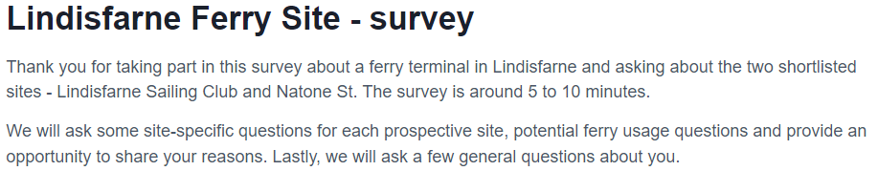
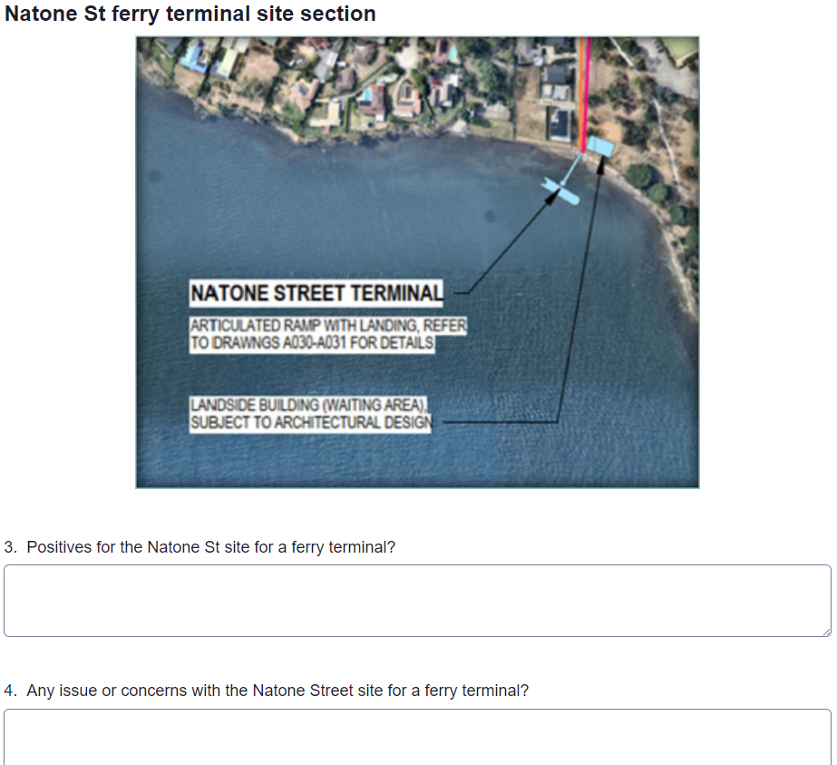
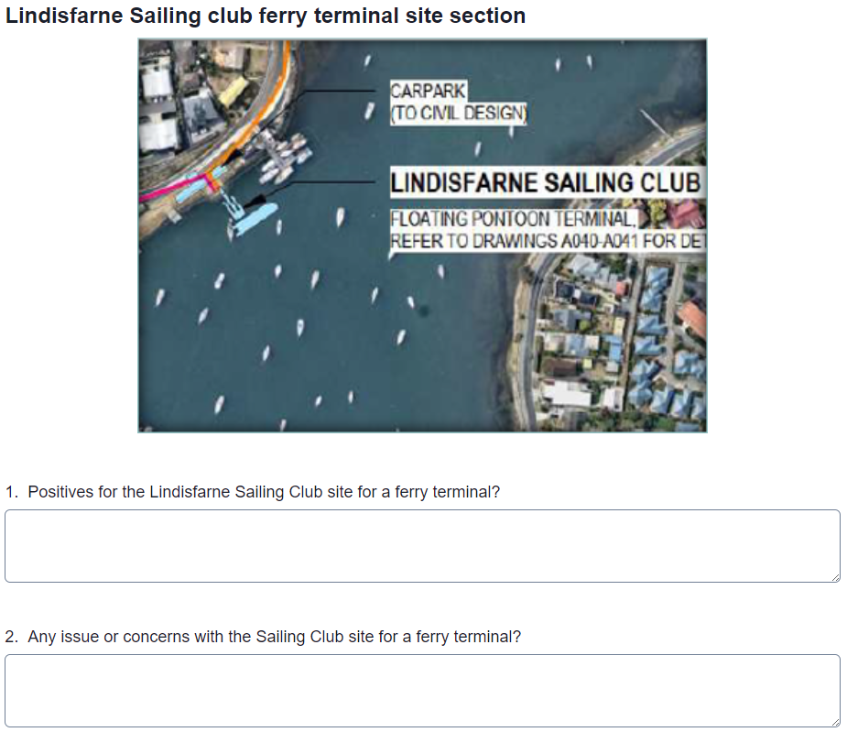
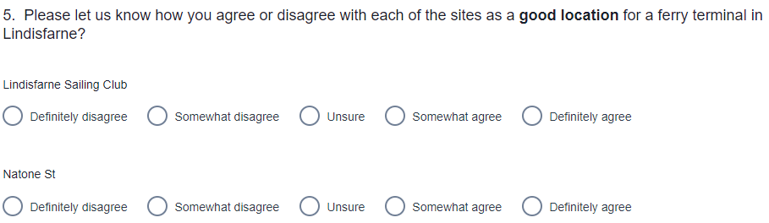
What was asked - online survey questions

Slide 23
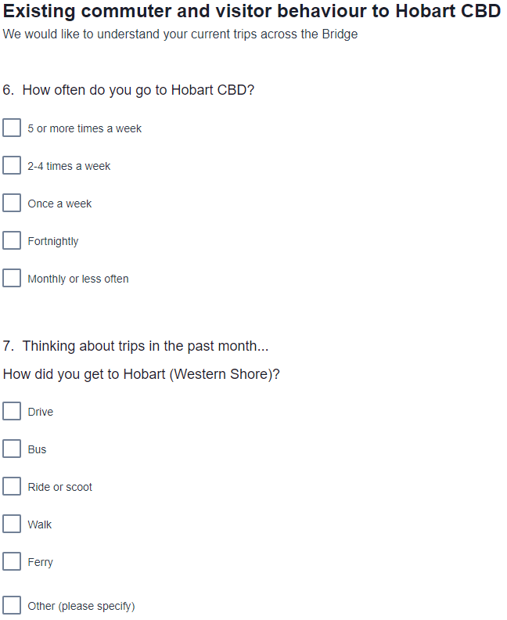
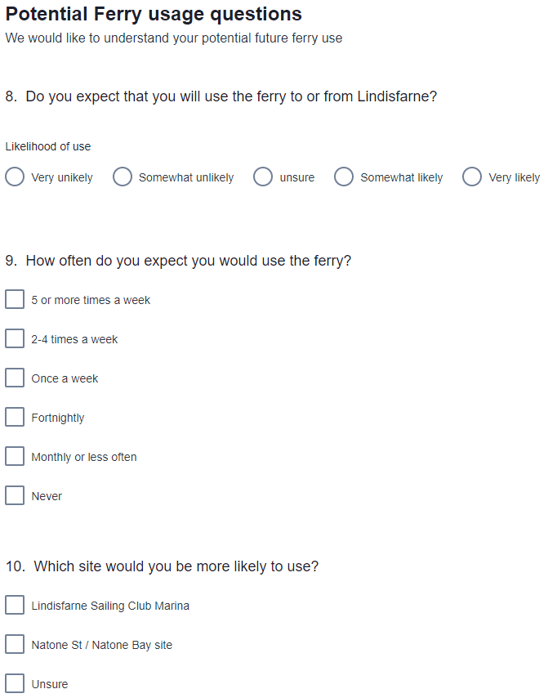
What was asked - online survey questions

Slide 24
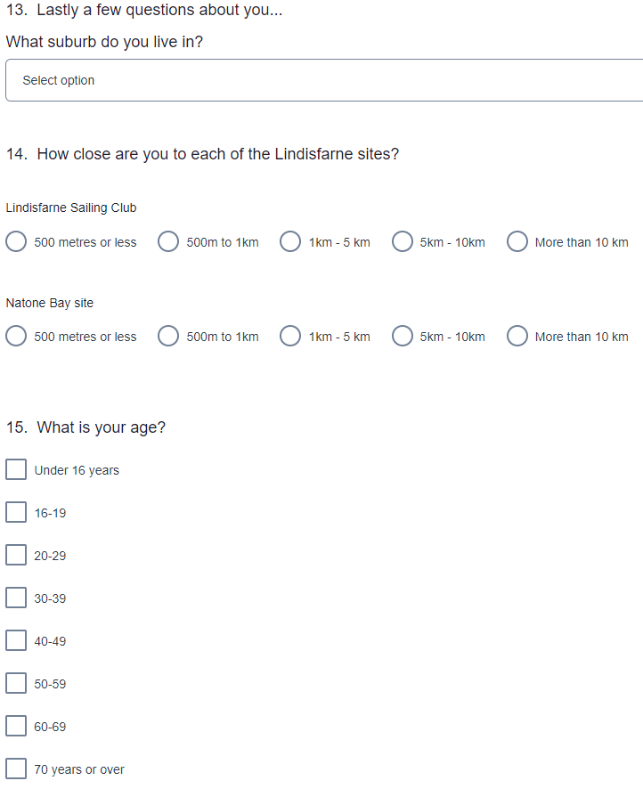
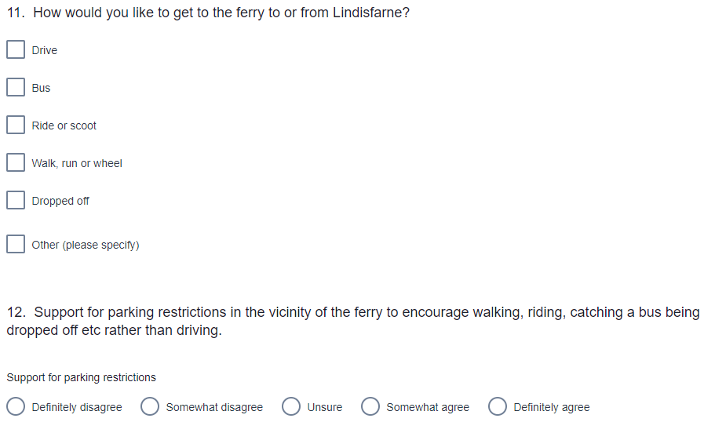
What was asked - online survey questions

Slide 25
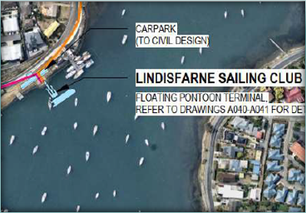
Q1. Lindisfarne Sailing Club site: positives
CENTRAL: more central / closer to shops & village / better for businesses/less impact on homes (already non-residential) | 130
LESS EXPOSED: sheltered/ calmer waters /larger site / closer to city - shorter trip | 58
BETTER CONNECTED - easy to walk to / bike paths / existing bus/safer & well lit | 50
GOOD SITE: great spot / established site (infrastructure there)/cheaper (expectation) | 45
ACCESS: convenient / easy access / flat | 35
PARKING: carpark / better parking | 34
LARGER CATCHMENT: good for community/will be used more/close to more people | 25
BENEFIT: will benefit the sailing club & community facilities/site needs upgrading | 25
BRIDGE: will ease traffic / improve commute | 13
USERS: better for visitors / easier to access for Rose Bay & Geilston Bay | 6
PIER: good location for café / restaurant | 5
ELDERLY: close to retirement village (gives access to town) | 5
PERSONAL SAFETY: safer at night (passenger safety)/more visible | 2
NONE: none /not supported | 170

Slide 26
Q2. Lindisfarne Sailing Club site: concerns
OTHER USER IMPACTS: impact on other existing users of the water/impact on MYCT/Dragon Boats/wash and safety concerns/moorings will go/access for other users impacted | 191
PARKING: parking concerns/enough parking?/the MYCT car park will be used/tennis parking will be used | 149
TRAFFIC: roads/traffic congestion/pedestrian safety with more cars/drop off area | 38
SLOWER: slower ferry trip/further distance to town/ further from other stops/difficult approach | 34
LOSS OF SAILING CLUB: will it impact sailing club activity? Will disrupt sailing club/Loss of the sailing club? Displacement of sailing club/loss of community space/would need significant upgrade/will fitness lessons still happen? children's sailing impacts? | 26
BUS: will there be a bus? how could a bus fit? | 23
CONNECTIONS: connections and access/ensure walking/cycling/wheelchair access /commuter rush impacts | 12
RESIDENTS: impact on local residents/annoying for residents/ferry commuters parking on streets/noise | 10
SITE: not a good site/other sites should be first (Howrah, Kingston) | 6
MISC: yes concerns - no further information | 4
TIMETABLE: what will the timetable be and clarity on impacts on existing users? ferry schedule will be impacted with a busy bay | 3
DEMOGRAPHICS: Lindisfarne is elderly/won’t use the ferry /will be used by Montague bay and Geilston Bay residents | 5
WILDLIFE: impact on local wildlife/dolphins | 3
COST: who will pay? | 1
NONE: none/no concerns/will improve ageing infrastructure/love this | 76

Slide 27
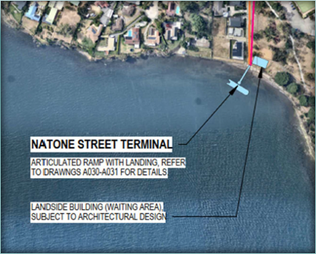
Q3. Natone Street site: positives
LESS IMPACT ON WATER USERS: away from other users/safer for other water users / no moorings / turning circle easier/less impact on other water users/out of the way/away from services | 140
FASTER TRIP: faster ferry (no need to drop speed)/clearer access/less used bay/safer for other water users | 90
CAR PARKING: more car parking/potential car parking/use park parking/can remove playground for more parking | 87
BLANK SLATE: a good site/also good/blank slate less constraints/another option/more space/less costly | 57
RESIDENTIAL AREA: access/easy to get to/easy to drive to/more residential area | 20
AWAY FROM VILLAGE: less busy area/quieter part of Lindisfarne/more residential/less traffic/away from village and shops/closer to recreation/low traffic area | 15
BUS SPACE: more space for a bus/more space for a drop off area | 13
GEILSTON BAY: convenient location/closer to Geilston Bay | 12
GENERAL SUPPORT FOR LINDISFARNE: support a ferry in Lindisfarne (not location specific) | 10
REDUCE BRIDGE TRAFFIC: support ferry/reduce traffic on bridge/cars off roads | 7
LESS RESIDENTS IMPACTED: less impact on residents (who live near Sailing Club)/less residents near Natone St to impact (lower volume)/away from older residents/tucked out of view | 5
SAILING CLUB: won't impact sailing club/will allow Sailing club to continue/ won't be displaced | 4
MAY IMPROVE PARK: may get better footpaths/ better park investment adjacent/next to park | 3
ACCESS: near bike track | 2
GOOD: good for community/good for businesses | 2
NONE: not as good a site/further away/more residential (better near activity)/would use it less/too far to walk/ruin green space/too exposed | 75

Slide 28
Q4. Natone Street site: concerns
PARKING: less parking/will need more parking/easy drop off created/more will drive to this location (more parking needed)/use part of the park for parking | 105
EXPOSED: too exposed/windy/will need a break wall/infrastructure/no toilets/more expensive/shallower water/not as safe | 77
LESS CENTRAL: not as central/further from shops (less benefit to them)/dark and less safe at night/lonely spot /not as good/will be used less/smaller catchment/further from school | 44
ISOLATED: more isolated/longer walk & less safe to walk to /distance from many residents /further away/too far from village/too far for older residents/not central/away from services/more isolated | 43
RESIDENT IMPACTS: too close to houses/more impacts on residents/end of a residential street/residential area/more difficult access (dead end street) | 35
LESS WALKABLE (BIKE &BUS): less links/harder to access by active travel and PT/will need more direct DDA pedestrian access/need easier walking and cycling access/further from bus stops/less safe to walk to and hillier/dark walkways/restricted access in front of properties | 33
TRAFFIC: will increase local traffic congestion and noise and ferry light impacting nearby residents/traffic flow/it's a bottle neck/harder to drop off | 27
PLAY /DOG PARK: too close to park/will impact users of the recreation spaces (use their parking)/don't turn park into parking/more cars dangerous for children and dogs/disrupt popular walking route/won’t look nice next to park /off leash dog park impacts/safety risks to dogs (increased traffic) and dog park parking/beach is used by dogs and people | 21
EMPTY SITE: no existing infrastructure/expensive/big pier would be needed/no toilets | 13
ROSE BAY: further from Rose Bay users/would drive instead of ferry | 6
SAILING CLUB: sailing club will cease to exist | 2
MISC: other concerns | 4
NONE: none/no concerns/best /nil/no/not sure | 141

Slide 29
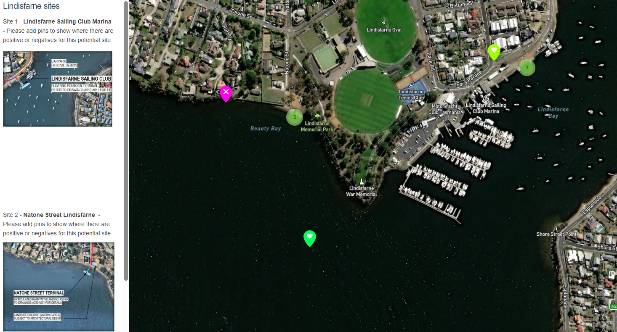
Map tool comments for additional site feedback
Lindisfarne Sailing Club site pinned comments
Lindisfarne Sailing Club - positive | this site would allow the best access for the largest number of future passengers
Lindisfarne Sailing Club - positive | I like that this is closer to the village, schools and care homes, so less walking for many visitors. Also probably more sheltered against prevailing winds.
Lindisfarne Sailing Club - positive | Move it to Geilston Bay to provide the opportunity for expansion. Consider the additional houses being built north of Lindisfarne still accessible to everyone
Lindisfarne Sailing Club - positive | good to add a bike path and walking track from both directions along the foreshore.
Lindisfarne Sailing Club - positive | A good opportunity to filter out through-traffic to local access <30km/h; the cars use highways to get around, so there's no reason the coastal routes have to be hazardous. AAA multimodal paths will be the most important connector for ferries (eg electric mobility or between buses) and waiting areas for diverse users.
Lindisfarne Sailing Club - positive | The ferries could have a good symbiosis with transit-oriented development. More people living affordably & parking-lite in these high-amenity locations (by water and parks) close to public transport means that they can maintain service patronage & justify further expansions while requiring less surrounding car parking & traffic (further freeing up land for more housing & amenity, & encouraging users from further afield to take advantage of the improved infra).
Natone Street site pinned comments
Natone St - positives | Natone Street option offers better parking and access than the Sailing Club which has limited parking and will create traffic/parking issues for residents.
Natone St - positives | Too dangerous for a ferry in and out of Lindisfarne Bay.
Natone St - positives | Natone - positive - safer option
Natone St - negatives | Mostly residential area, limited access from other public transport
Natone St - negatives | Private property boundaries in this direction extend to the water and rocks. There might also be fewer passengers in this catchment area (Derwent Ave) compared to a more central area in Lindisfarne where a terminal and infra upgrades would be more visible from existing recreation and retail areas serviced by land PT.

Slide 30
Q5. Lindisfarne Sailing Club site – level of agreement as a good location for the ferry terminal
45% of respondents agree that Lindisfarne Sailing club site is a good location for a ferry terminal in Lindisfarne
Lindisfarne Sailing Club Site
Agree
46%
Disagree
50%

Slide 31
Natone St site
Q5. Natone Street site – level of agreement as a good location for the ferry terminal
65% of respondents agree that Natone St is a good location for a ferry terminal in Lindisfarne
Natone St Site
Agree
66%
Disagree
25%

Slide 32
Current community transport behavior
Overall travel to Hobart CBD is high with 83% going to Hobart CBD weekly or more often.
Current transport is driving for most (68%). Bus and Ferry (Bellerive) are the choice for some.
Q6. How often do you go to Hobart CBD?
Q7. Thinking about trips in the past month...
How did you get to Hobart (Western Shore)?
Weekly or more often
83%
Average number of transport types 1.3

Slide 33
Q8. Do you expect that you will use the ferry to or from Lindisfarne?
Potential ferry usage questions
7 in 10 expect to use a ferry from a location in Lindisfarne
Likely
70%
Unlikely
21%

Slide 34
Q9. How often do you expect you would use the ferry?
Potential ferry usage questions
6 in 10 expect to use the Lindisfarne ferry once a week or more often
Weekly
or more often
60%

Slide 35
Q10. Which site would you be more likely to use?
Potential ferry usage questions
Overall likelihood to use each site is split. Natone St has 47% of respondents saying this is more likely to be used, 35% for Sailing club with another 18% unsure or happy with either site for use.
Overall respondents

Slide 36
Sites by potential user types
The residents who are most likely to use the ferry are split equally on the site they are most likely to use 43% for either site.
Residents who are unsure or say they are unlikely to use have a clear preference for Natone St (reflecting concerns for potential impacts).
0
Overall respondents
High future use
Low future use
Unsure
Likely to use (n=430)
(very and somewhat likely)
Unlikely to use (n=124)
(very and somewhat unlikely)
Unsure about use
(n=57)
Do you expect that you will use the ferry to or from Lindisfarne?
Which site would you be more likely to use?

Slide 37
Q11. How would the community like to get to the ferry?
Nearly 7 in 10 would prefer to get to the Lindisfarne ferry without using a car.
Only 3 in 10 would like to get to the ferry by car.

Slide 38
Q12. Support for parking restrictions
52% of respondents support parking restrictions at the chosen site for the ferry terminal.
Agree
52%
Disagree
32%

Slide 39
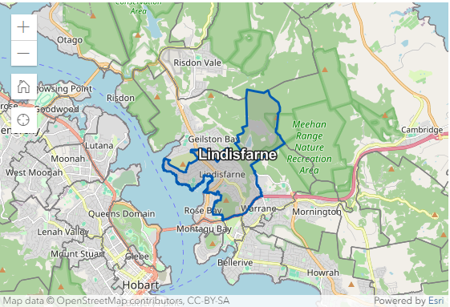
Q 13. What suburb do you live in?
Responses from right across Clarence with a strong representation from the immediate surrounding suburbs.
93% of respondents live in Clarence.
73% of respondents were from three key suburbs including Lindisfarne, Geilston Bay and Rose Bay.
Some respondents living outside Clarence identified that they have a mooring in the Bay.

Slide 40
Q14. Proximity to each site
We aimed to gain feedback from residents and potential users in the immediate vicinity of the ferry sites.
We are pleased that we attracted strong interest from the local community
Lindisfarne Sailing Club Site
Natone Street Site

Slide 41
Q15. Age of respondents
Age breaks capture a good range of ages and perspectives
Survey Respondents ages
ABS 2021 Census Lindisfarne All persons QuickStats.

Slide 42



Census demographics – Who lives in Lindisfarne?
People | 6,639
Male | 46.6%
Female | 53.4%
Age
19 years and under | 18.3%
20-29 years | 11.2%
30-34 years | 13.0%
40-49 years | 10.6%
50-59 years | 10.4%
60-69 years | 12.4%
70 years and over | 24.1%
Median age | 46
Families | 1,750
Average number of children per family | 1.7
All private dwellings | 2,863
Average number of people per household | 2.3
Participation in the labour force | 3,126
In the labour force | 54.8% (3,126)
Not in the labour force | 41.1% (2,343)
Lindisfarne median age is 46 years
45% of the population in Lindisfarne is between the ages of 20 and 59 years (working ages)
54.8% of the Lindisfarne community participate in the labour force
2021 Lindisfarne, Census All persons QuickStats | Australian Bureau of Statistics (abs.gov.au)
ABS 2021 Census Lindisfarne All persons QuickStats.

